Slide 1
Laura Merson
ISARIC-WHO Clinical Characterisation Protocol

Slide 2
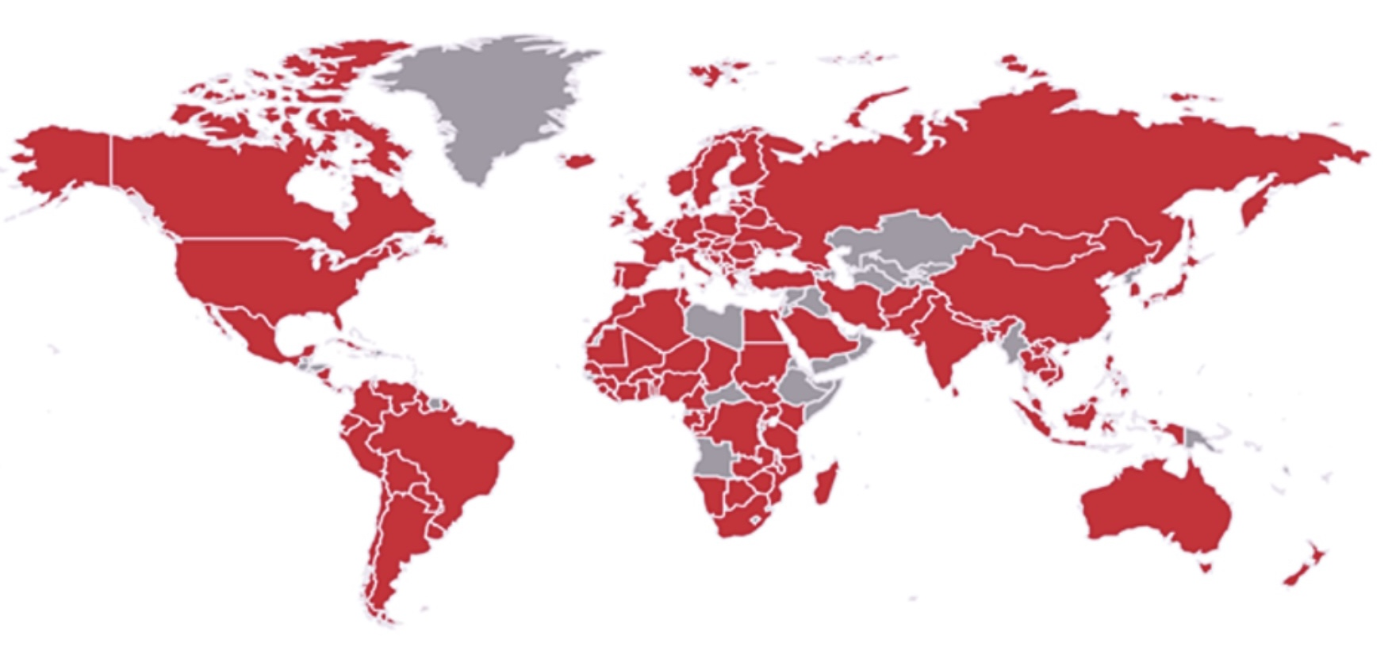
International Severe Acute Respiratory and emerging Infections Consortium (ISARIC)
ISARIC is a grassroots, investigator-led federation of hospital-based research networks committed to improving outcomes for patients with emerging infectious diseases.
Since 2012, ISARIC has championed a coordinated, agile approach to global clinical research, accelerating the generation of critical knowledge to save lives in epidemics and pandemics.
ISARIC’s APPROACH:
Prepare: pre-approved, standardised protocols and CRFs
Collaborate: inter-pandemic
Integrate: clinical research into public health responses
Share: context-adaptable tools, expertise, and data
Trust: built up over years
ISARIC has 78 network members across 133 countries
Notes:
As brief introduction, ISARIC is a federation of investigators who, for more than a decade, have championed the development of a coordinated, agile approach clinical research on emerging infectious diseases.
ISARIC's creation was a response to the lack of actionable research evidence generated during the 2009 H1N1 pandemic. This collective failure of the global research community forced the recognition that we were ill equipped to deliver the research needed to respond to outbreaks REAL TIME.
From this, a grassroots initiative emerged to tackle the challenge of improving patient outcomes during outbreaks. The strategy included the development of pre-approved, standardised protocols and data tools to support the integration of research into the public health response.

Slide 3
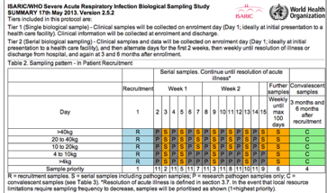
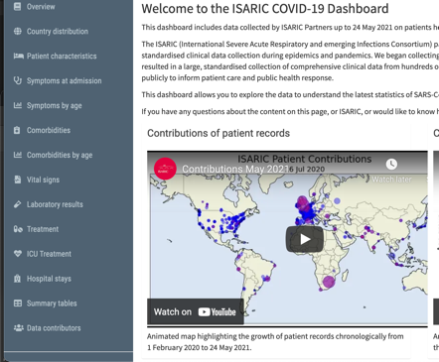
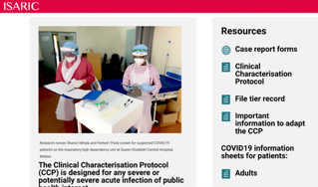
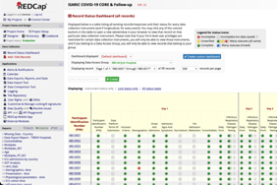
OUTBREAK RESEARCH PREPAREDNESS
ISARIC-WHO Clinical Characterisation Protocol, Tools & Support, circa 2012
A flexible protocol designed to inform the major questions of acute illness from an emerging pathogen or exposure: transmission, natural history (pathogen & host), mechanisms of severity and how to influence them.
Protocol
CRF
Additional
investigator-driven modules
Reports & data visualisation
Availability of local resources
Tier 2 Serial Biological Sampling
Surge pressure on local resources
Tools & Resources
Data System
Tier 1 Single/Limited Biological Sampling
Tier 0 - Data Collection Only
Cases recruited over time
… data management, grant applications, modelling, implementation, ethics, DPIAs, etc…
Notes:
Outbreak research readiness and response - Establishing high quality research studies, expertise and infrastructure
between epidemics and pandemics is what enables us to respond quickly and generate high quality evidence.
Universal protocol with a FLEXIBLE approach
Builds open-access research tools and databases which are flexible, resource-appropriate and pragmatic
Prepared and shared in advance of an outbreak
Protocol
CRF & eCRF: Core data elements + modules for diseases, syndromes, follow-up, procedures
Grant applications: library of excerpts to support other sites to write their own applications
Data management: regional REDCap systems hosted, harmonised, updated and managed at Oxford
Data visualisation: dashboard code that can be locally tailored and hosted to a site/network/region
SOPs and other implementation tools : library of template documents, Ethics support materials
Central database for data pooling/sharing
Data sharing mechanism and partner analysis scheme

Slide 4




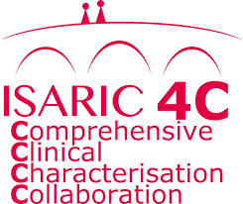

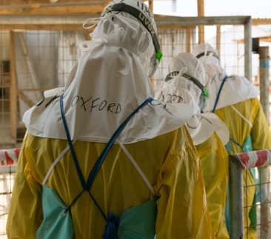

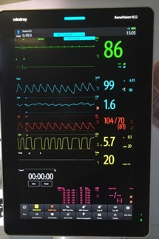

CCP IMPLEMENTATION for RESEARCH RESPONSE
ISARIC-WHO Clinical Characterisation Protocol & Case Report Forms 2012-2019
Adapted & adopted
Ebola
MERS
Zika
PPHI
SARI
Notes:
From it’s inception in 2012 up until 2019, CCP was used in many outbreaks
Ebola
Zika
SPRINT-SARI - As an international point prevalence study during influenza seasons in 19 countries
ISARIC4C - As a nationally approved sleeping protocol ready to respond to any pathogen of public health importance
In Saudi Arabia in response to MERS-CoV

Slide 5


CCP IMPLEMENTATION for RESEARCH RESPONSE
ISARIC-WHO Clinical Characterisation Protocol & Case Report Forms
2019 SARS-CoV2 EMERGES
Experience from many applications of the CCP informed a COVID-19 adaptation
ISARIC-WHO COVID-19 Clinical Characterisation Protocol & CRFs
~1 million hospitalised people with COVID-19
83 countries, >1,800 sites, >50% from LMICs
Notes:
in 2020, the culmination of the experience gained across the multiple implementations was used to pivot the protocol toward COVID-19. The tools were adapted and shared internationally which led to wide spread uptake

Slide 6


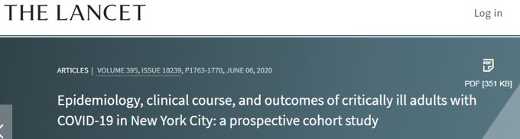

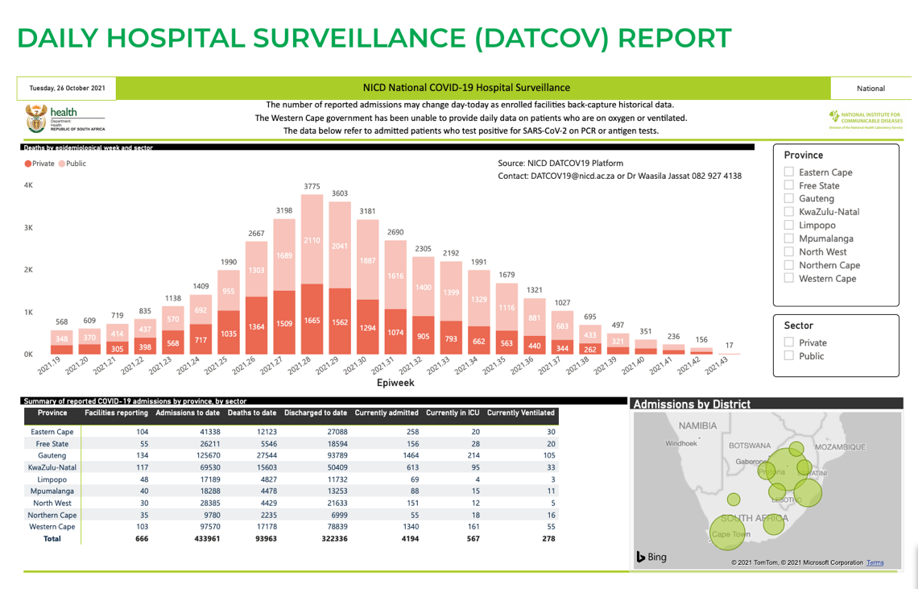
CCP TOOLS USED FOR EARLY COVID-19 EVIDENCE
Clinical course and outcomes of critically ill patients with SARS-CoV-2 pneumonia in Wuhan, China: a single-centered, retrospective, observational study
Features of 20 133 UK patients in hospital with covid-19 using the ISARIC WHO Clinical Characterisation Protocol: prospective observational study
CCP EVIDENCE INFORMED NATIONAL POLICY AND PLANNING ACROSS SEVERAL COUNTRIES, MANY CLINICAL TRIAL DESIGNS, REGULATORY SUBMISSIONS…
Notes:
THe ISARIC CCP Case Report Form was used in many of the earliest collections and descriptions of COVID-19
Several MoH and NPHIs used the tools for national reporting systems

Slide 7

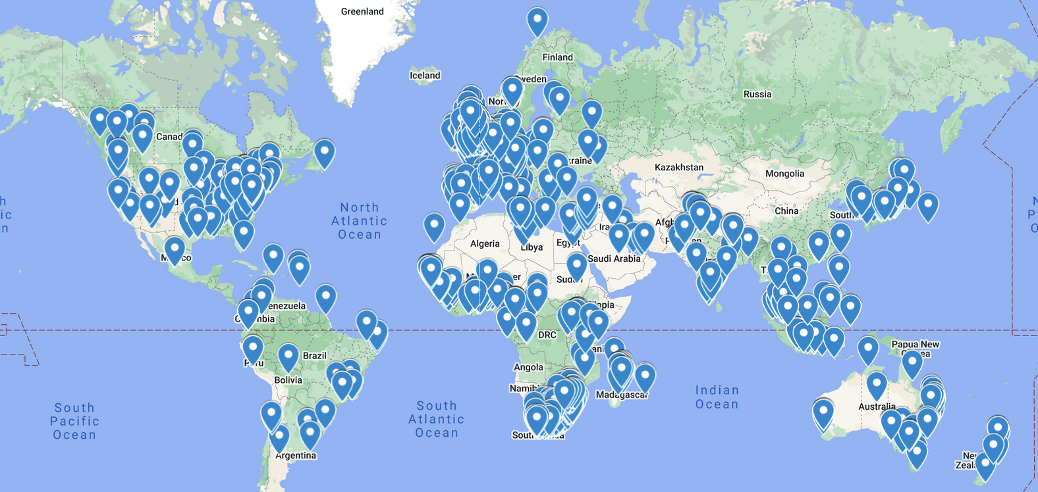


DATA SHARING and COLLABORATIVE ANALYSES
~1 million patient records
>180 manuscripts
x̄ 1,250 cited contributors/manuscript
83 countries
>1,800 sites
>2,500 contributors
19 clinical reports
4 clinical dashboards
Notes:
>1800 sites across 83 countries contributed data to a central platform for sharing and collaborative analysis

Slide 8
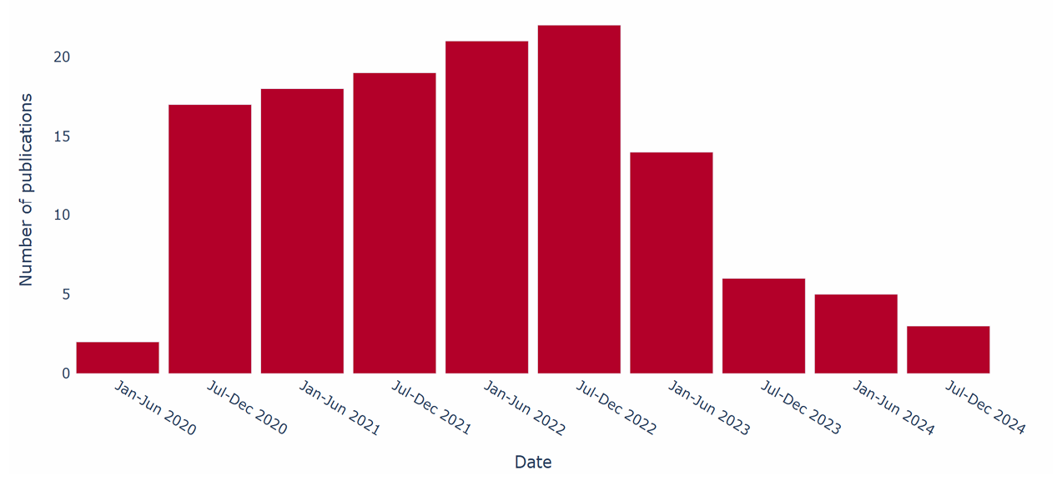
Peer-reviewed publications using ISAIRC COVID-19 Dataset
DATA SHARING and COLLABORATIVE ANALYSES

Slide 9

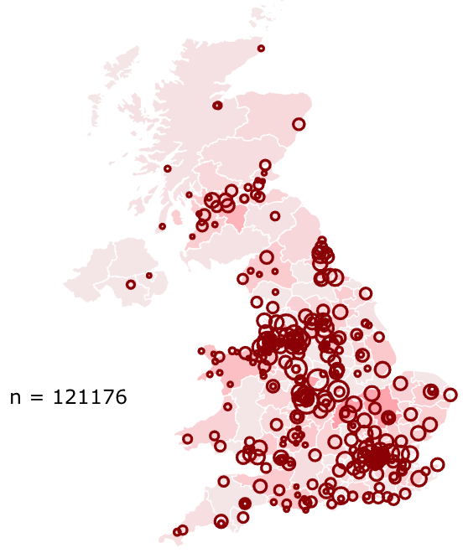
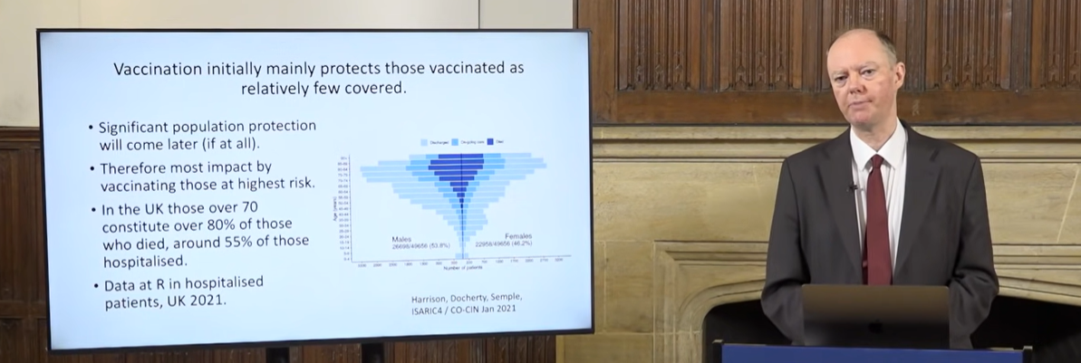


IMPACT of ISARIC’s CCP UK
From 11th March 2020, real-time analysis fed directly to Cabinet Office via SAGE and line level data shared with public health agency modellers and WHO.
Identified risk factors
Dynamic report on demography severity, and outcome
Resource planning
International Standards
Assay development and validation
Vaccine development
Vaccine efficacy & failure
Human Challenge Study
Harm identification & reduction
Public Health Policy
Patient Care Guidance
Audit of adoption of guidance
Pathogenesis
Genomic susceptibility
Enabled daughter studies
31st Jan 2020 to
28th Feb 2022
n = 303,251
from 348 sites
ISARIC4C’s demograph of COVID-19 outcome informed the vaccine rollout schedule in the UK endorsed by MHRA 2nd December 2020
“…it has captured a large proportion of UK hospital cases and it has proven extremely useful to both SAGE and SPI-M. It has, for example, been vital in identifying risk factors associated with poor outcomes as well as well as early signs of the prevalence of hospital-acquired infection.”
Sir Patrick Vallance, UK Government Chief Scientific Adviser and Head of the Government Science and Engineering Profession, written evidence to Parliament
24 July 2020

Slide 10
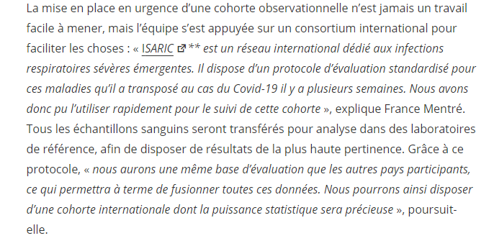
CCP COVID-19 in France - "French COVID"
​94 sites activated​
+4 300 patients recruited​
415 contributors cited in 16 manuscripts.
Sponsored by INSERM
Multiple funders
ISARIC template protocol approved by the Comité de Protection des Pesonnes
ISARIC template CRF adapted, data collected via REDCap and hosted at APHP.
Excellent collaboration with clinical and research staff across France.
Data sharing agreement with Oxford to pool and access data.

Slide 11

ISARIC-WHO Clinical Characterisation Protocol
A flexible protocol designed to inform the major questions of acute illness from an emerging pathogen: transmission, natural history (pathogen & host), mechanisms of severity and how to influence them.
CURRENT ACTIVATIONS
SARI
Mpox
Nipah & Acute encephalitis syndrome
Dengue
COLLABORATION
>1,000,000 patients
>1,800 hospitals
82 countries
OUTPUTS
>200 Manuscripts
>9,300 Citations
Dashboards
Policy & Planning
Clinical trial designs
Regulatory submissions
PAST ACTIVATIONS
Ebola
Zika
MERS-CoV
COVID-19
Acute paediatric hepatitis
TOOLS
Protocol
Case Report Forms
Operational tools
Procedures
Analytic pipeline
Notes:
Summary slide

